Slide 1
COMPUTER VISION
A Summary
Presented By-
V. Megha Saran

Slide 2
Visual Intelligence
Visual intelligence refers to the ability of a system (like a computer or a robot) to understand and interpret visual information from the world, much like humans do with their eyes and brain. It involves recognizing objects, people, scenes, and activities in images or videos, and making sense of them to perform tasks or make decisions.

Slide 3

Computer Vision is the technology and methods used to achieve visual intelligence in machines.

Slide 4
Introdunction to Signals & Images
Image processing can be done at various granularity levels –
Image Processing
Object Detection
Semantic Segmentation
Instance Segmentation
Instance Segmentation

Slide 5
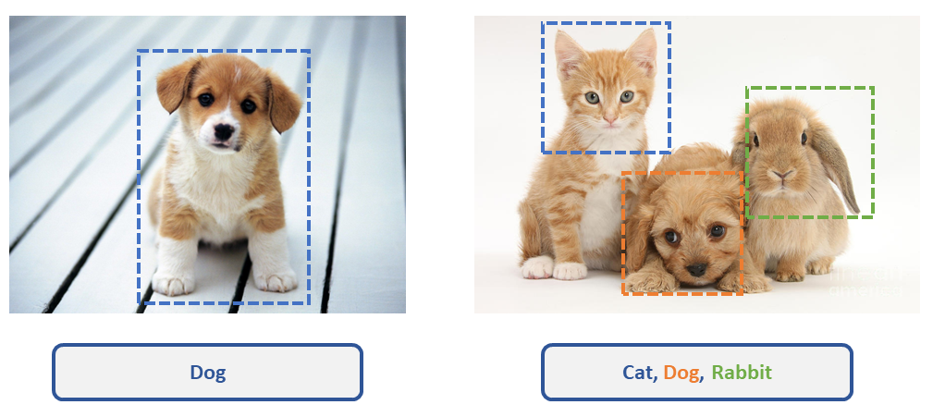
Image Classification
This task involves assigning a single label to an entire image. It identifies what main object or category the image belongs to.

Slide 6
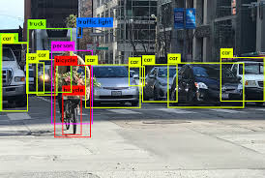
Object Detection
It not only classifies the objects but also provides bounding boxes around each object to show their positions.

Slide 7
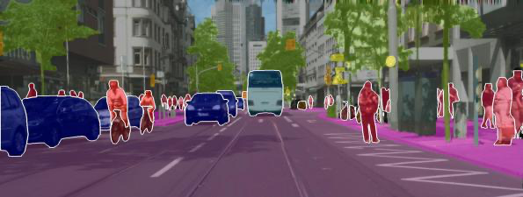
Semantic Segmentation
It involves labeling each pixel of an image with a class, providing a detailed map of the image. It not only detects objects but also distinguishes boundaries at the pixel level.

Slide 8
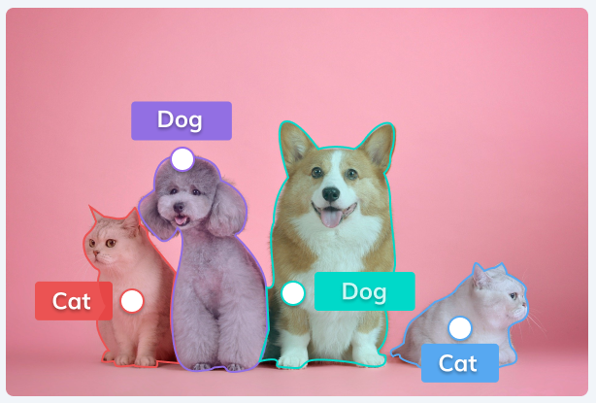
Instance Segmentation
This task combines object detection and semantic segmentation. It not only labels each pixel with a class but also differentiates between different instances of the same class.
Different Instances of the same class ‘Dog’

Slide 9
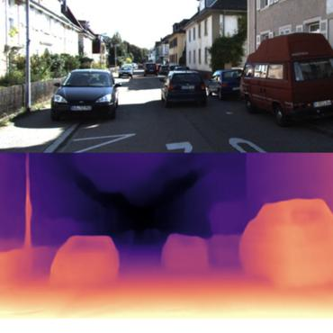
Depth Estimation
Determines the distance of objects or surfaces in the scene from the camera. It creates a depth map that shows how far each part of the image is from the viewpoint.

Slide 10
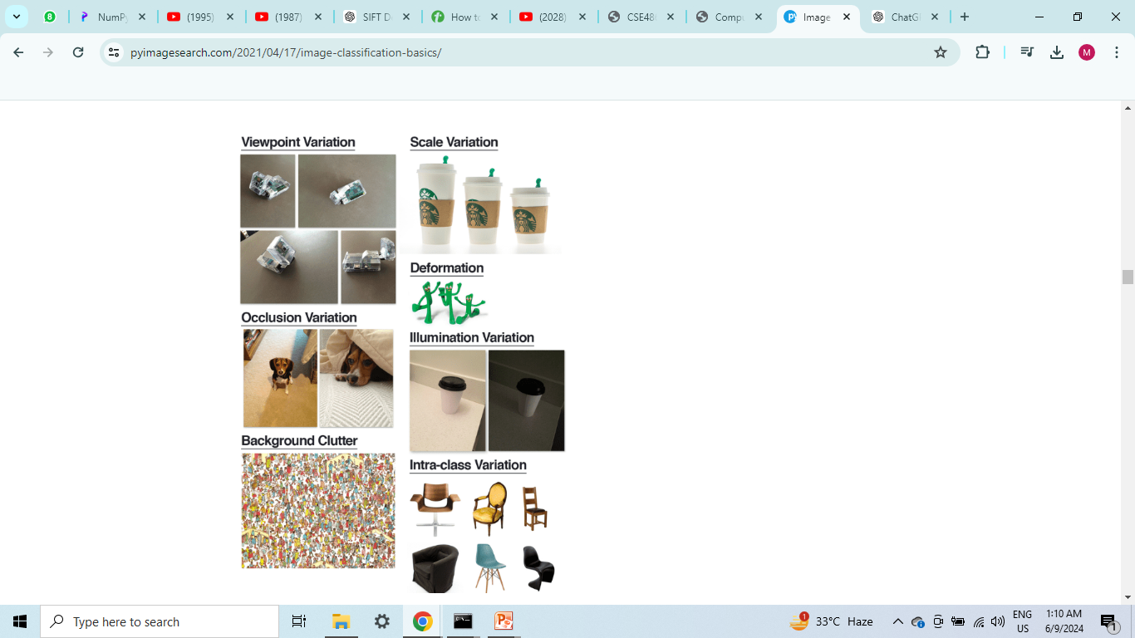

CHALLANGES

Slide 11
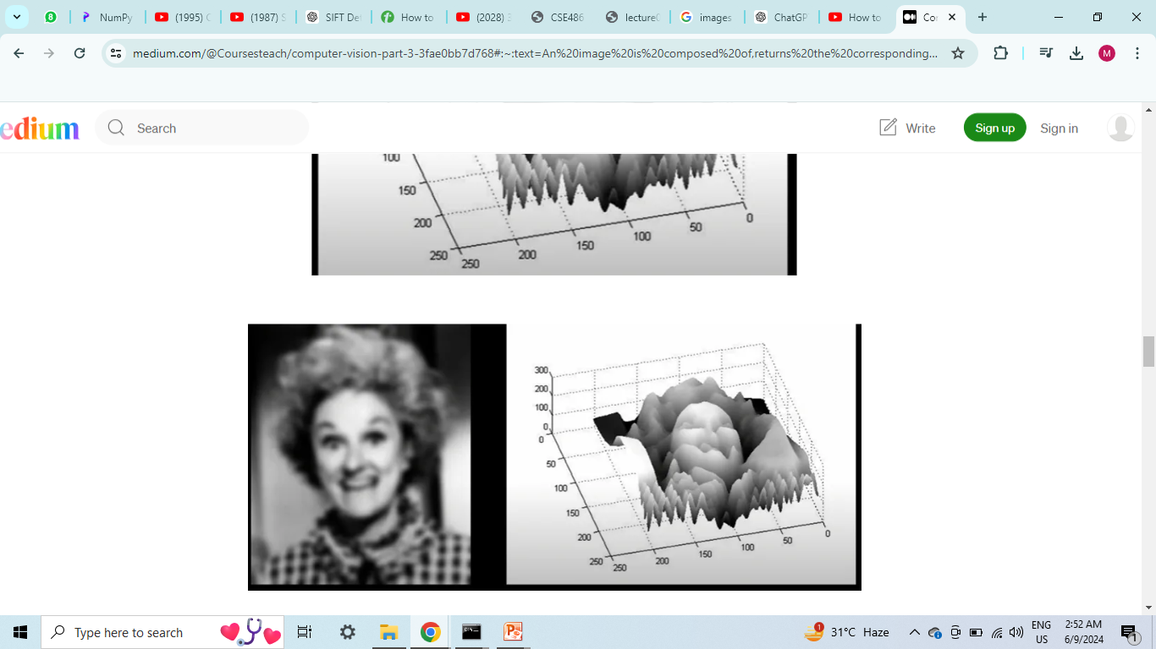
Images as Surfaces
How is image a function??
Images are essentially surfaces with points having x and y coordinates. The value at a point depends on (x,y) coordinates. Thus an image can be represented as a function f(x,y).

Slide 12
How to store an image??
B-Splines are piecewise polynomial functions used for approximation and interpolation of data.
Challenges with B-Splines?
Computational Complexity: B-Spline calculations involve solving polynomial equations, which is computationally intensive.

Slide 13
Storage of Images(Gray Scale)
To store an image in a computer and retain it, there are the following three steps:
Sampling : Sampling is the process of converting a continuous image signal into a discrete signal
Quantization : Quantization is mapping the continuous range of pixel values into a finite range of discrete values.
Sampling
Quantization
Encoding

Slide 14
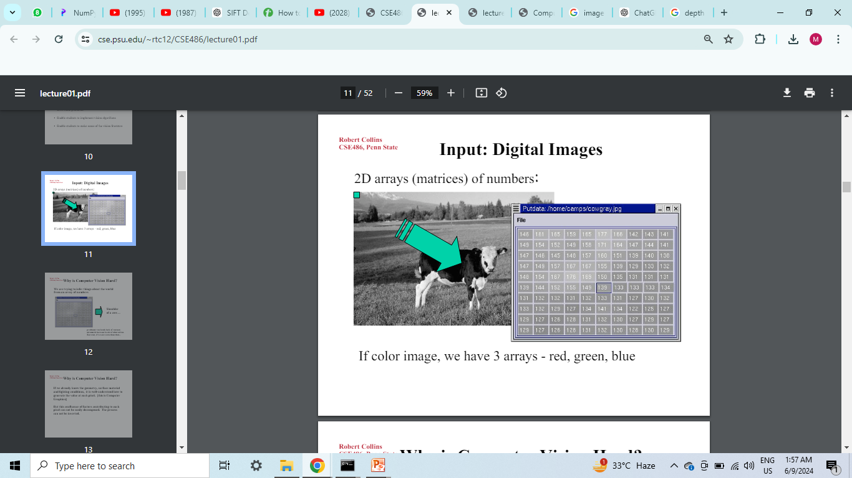
Encoding : Encoding is the process of converting the quantized pixel values into a format that can be easily stored or transmitted.
The standard quantisation has 256 levels(0-255).
Every sampling Point in the image is called a Pixel.
The total number of pixels is called Resolution.
The more the sampling,more is the details in image, and bigger is the matrix.

Slide 15
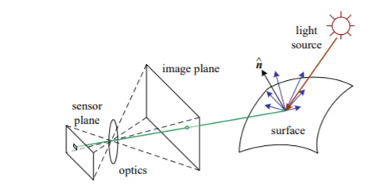
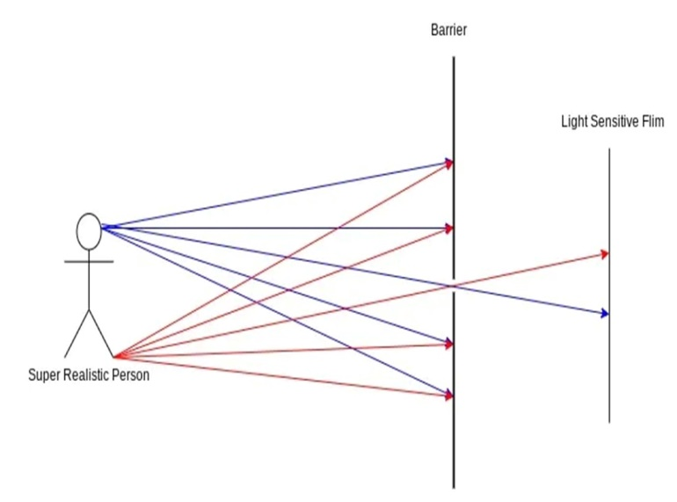
Image Formation
When a light ray falls on an object, reflects from it and then falls on a film or a screen, it forms an image.
Some models were used to make a clear image of the object-
Pin-hole model
Aperture model
Lens model
Depth of Field(DOF): The range in which an object is limited be placed, in order to have a clear and bright image.
Field of View(FOV): Describes the viewable area that can be imaged by lens system.

Slide 16
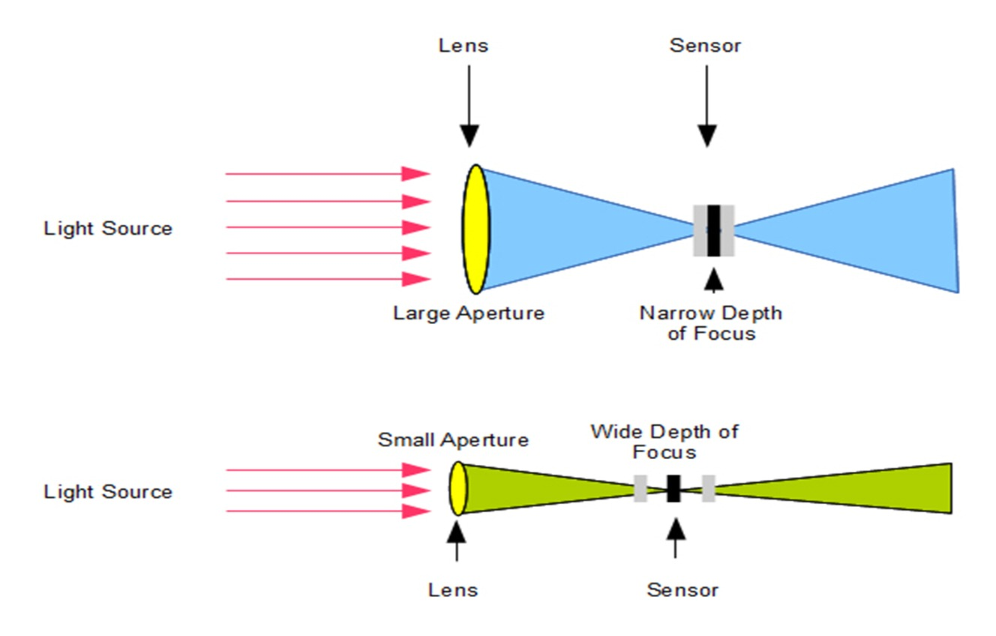
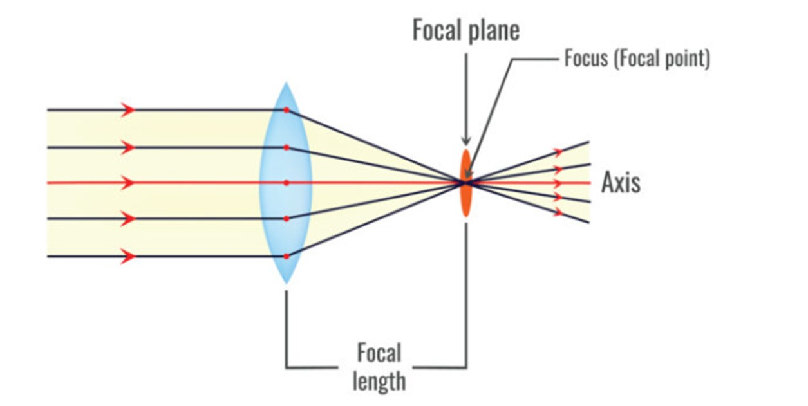
Relation b/w DoF and size of apperture
Lens Model

Slide 17
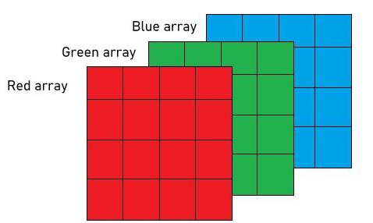
How are colored images stored?
Colored images are stored in the form of a 3D matrix or Triplet Matrix of size m×n×3. Each color makes a layer. One such model is the RGB model.

Slide 18


BASICS OF PIXEL RELATED OPERATIONS
If we are given a matrix with values between 0-255, can we generate an image back from it??

Slide 19
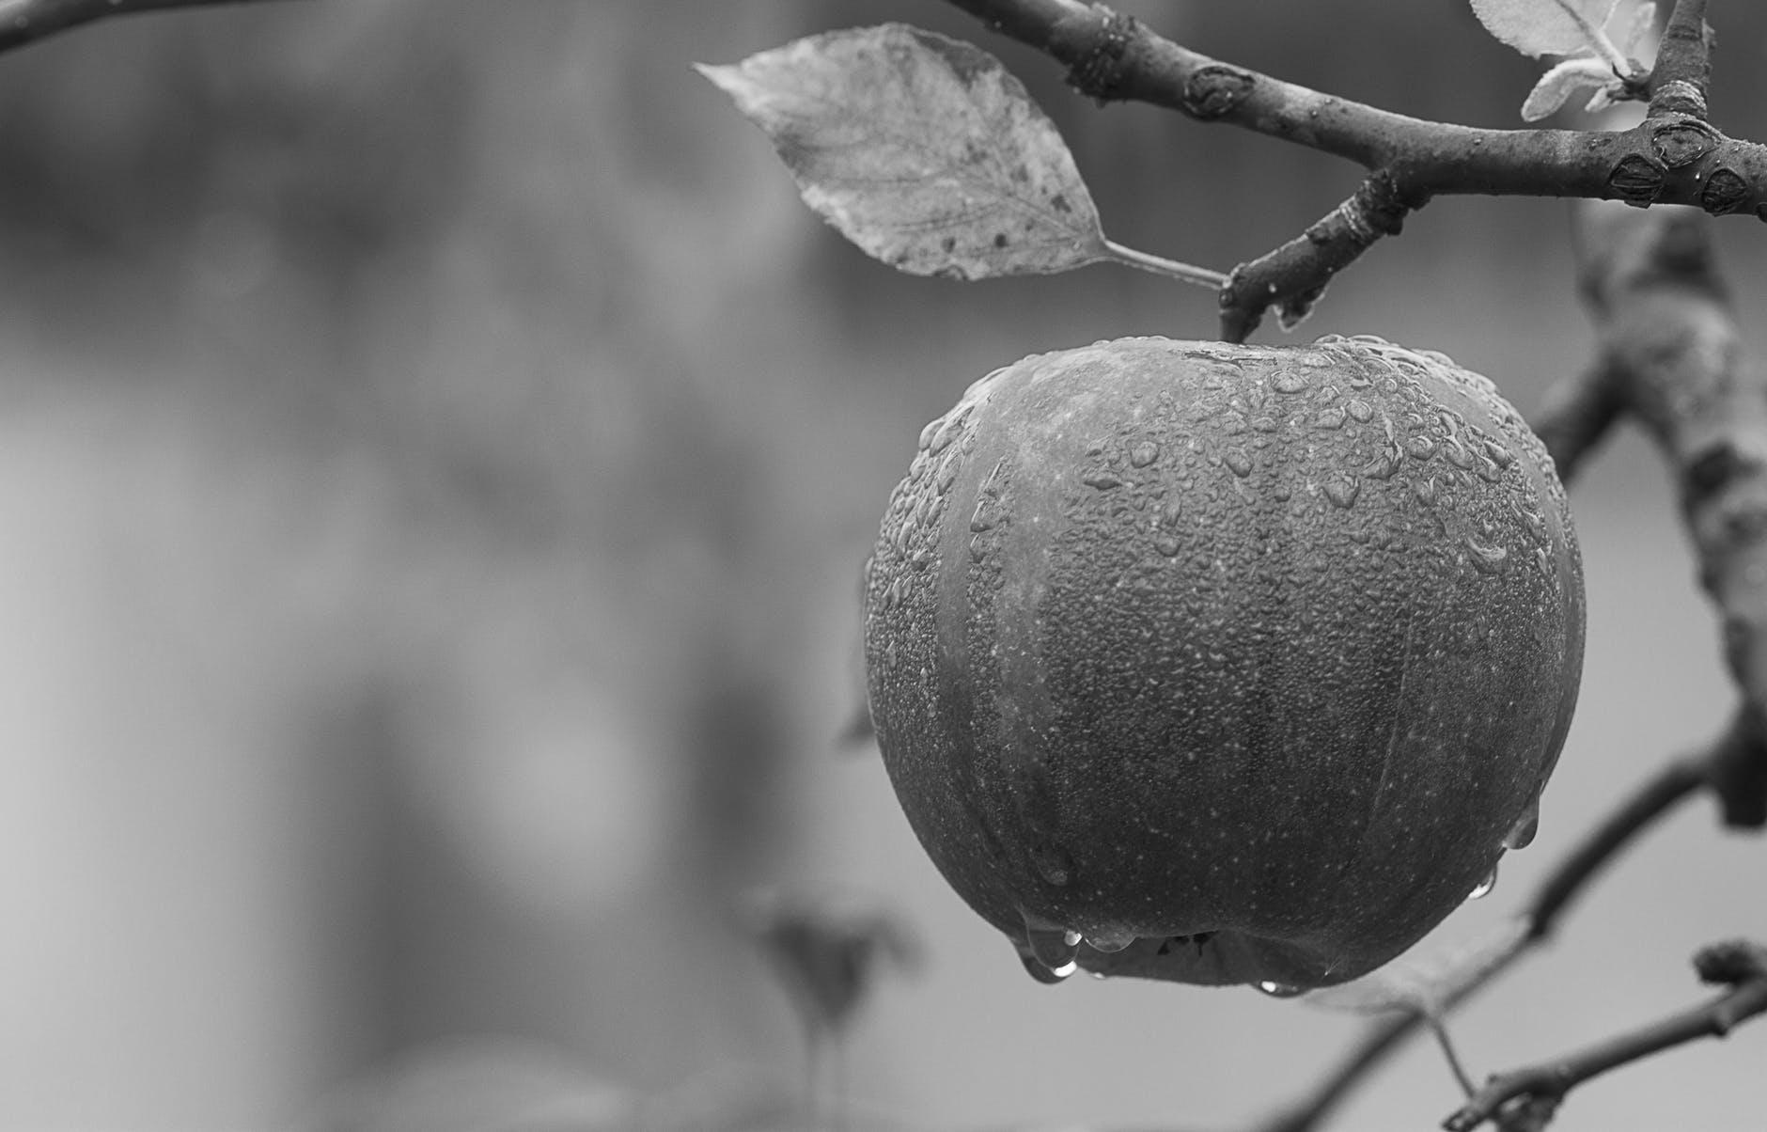
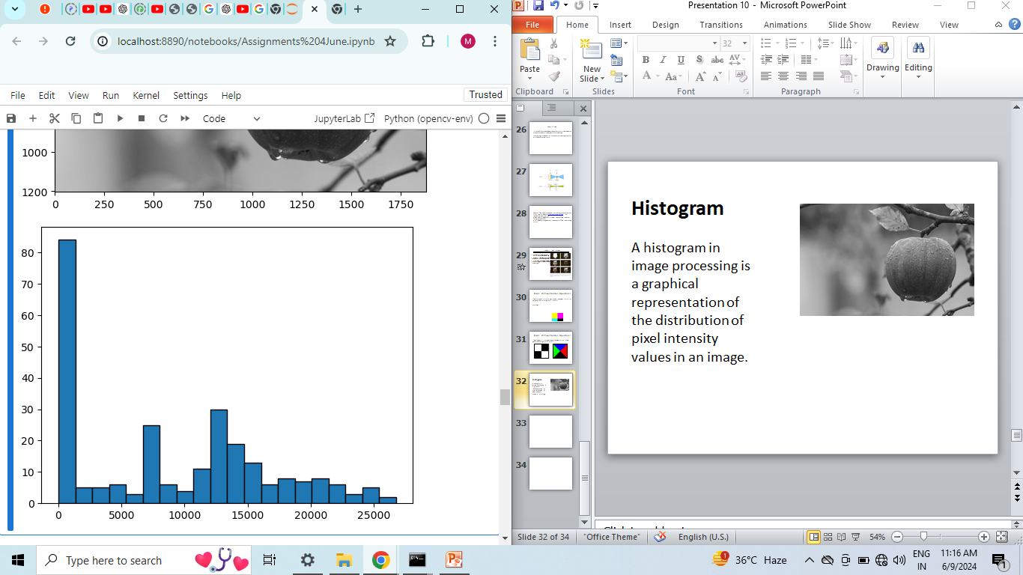
Histogram
A histogram in image processing is a graphical representation of the distribution of pixel intensity values in an image.

Slide 20
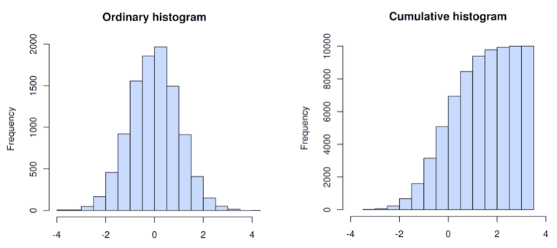
Cumulative Histogram
cumulative histogram is a plot of the cumulative frequency of pixel intensities in an image.
Cumulative Histogram
Ordinary Histogram

Slide 21

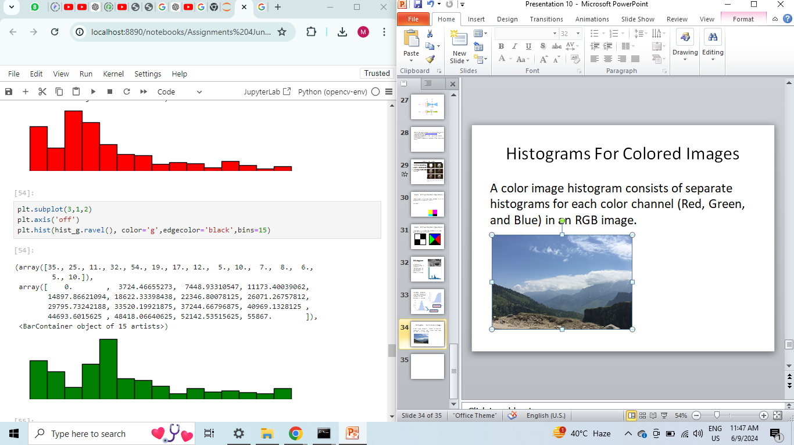
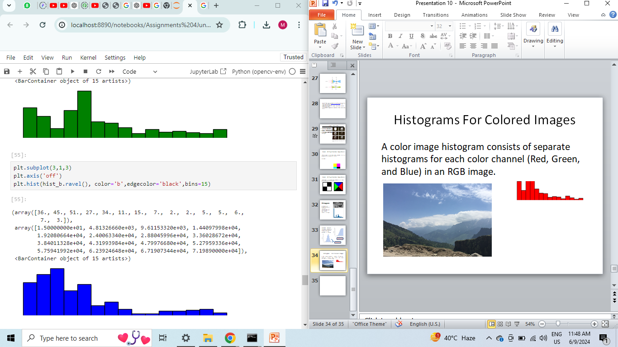
Histograms For Colored Images
A color image histogram consists of separate histograms for each color channel (Red, Green, and Blue) in an RGB image.

Slide 22
Histogram Equalization
Process: Transforming the histogram to be more uniform, enhancing the overall contrast of the image.
Steps: Calculate the histogram.
Compute the cumulative distribution function (CDF).
Use the CDF to remap the intensity values.
Outcome: Improved contrast of image and detail visibility.

Slide 23
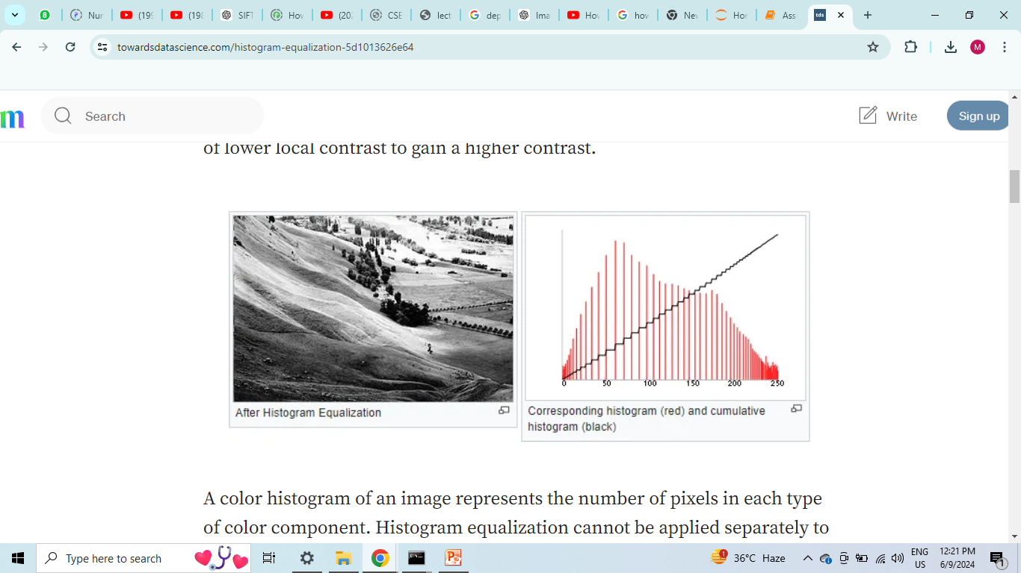
It achieves equalization by effectively spreading out the most frequent intensity values.

Slide 24

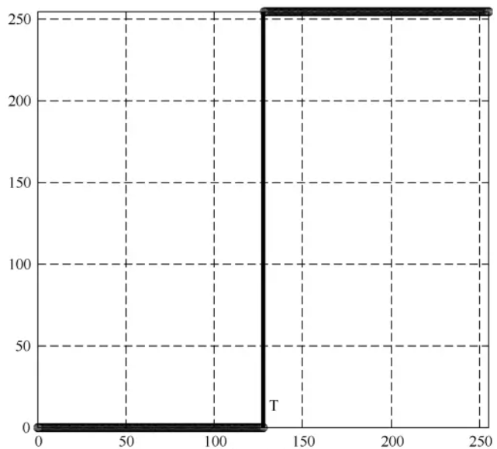
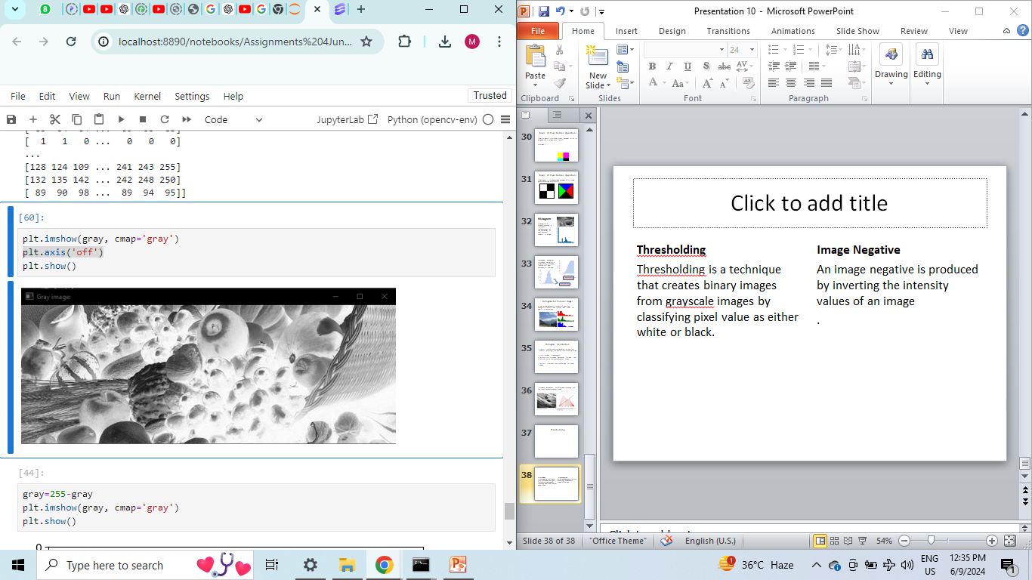
Thresholding
Image Negative
Thresholding is a technique that creates binary images from grayscale images by classifying pixel value as either white or black.
An image negative is produced by inverting the intensity values of an image
.

Slide 25
CONVOLUTION
Convolution is used to apply filters to images.
Image filtering is changing the pixel value of a specific image to blur, sharpen, emboss, or make edges more clear. It changes the appearance of the original image.
Mathematically it is an operation used to combine two functions to produce a third function.

Slide 26
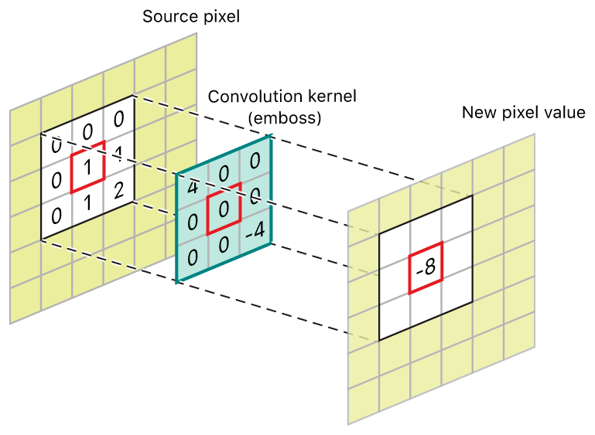
Convolution Process

Slide 27
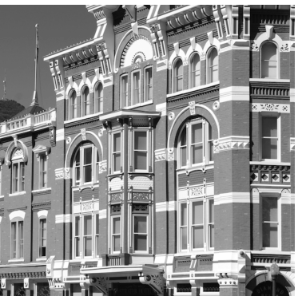
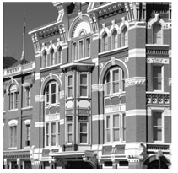
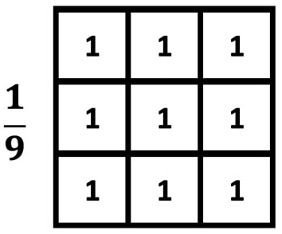
Averaging(Blurring)

Slide 28
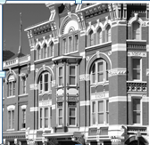
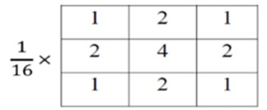
Gaussian Blur

Slide 29

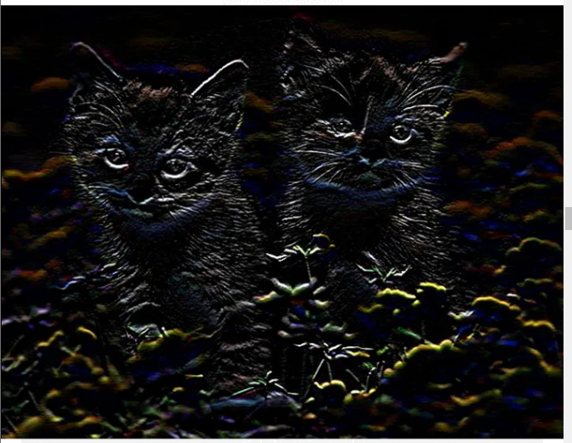
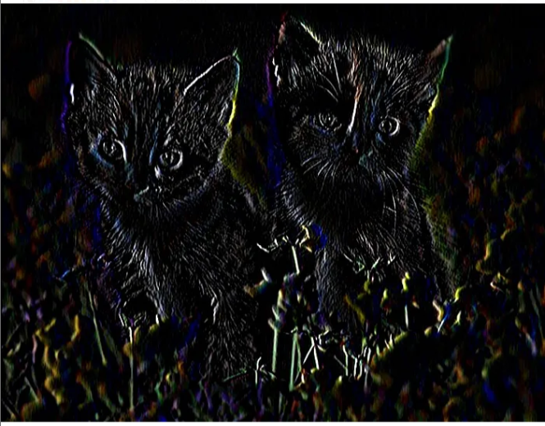
Derivative of Image
Derivative Kernel for vertical derivative
Derivative Kernel for horizontal derivative
1
-1
1 | -1

Slide 30
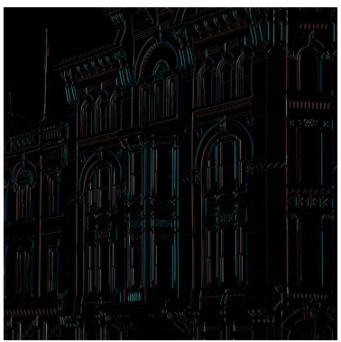
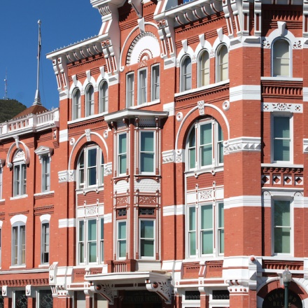
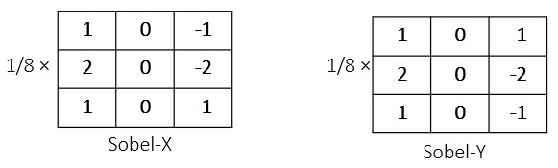
Edge Detection
Edge Detection in an image is done using Sobel filters. The image first undergoes smoothening/Gaussian Filter ,then its derivative is taken which finally gives the edges.
Sobel - Horizontal

Slide 31
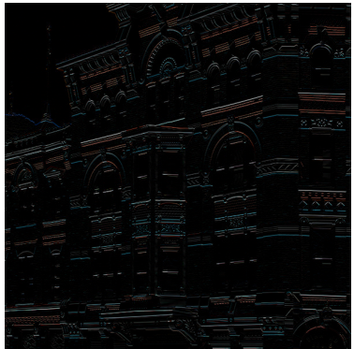
Sobel - Vertical

Slide 32
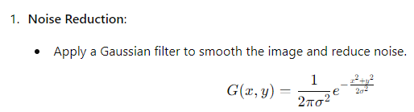
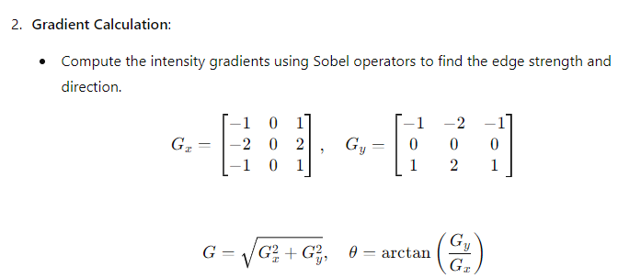
Canny Edge Detection

Slide 33
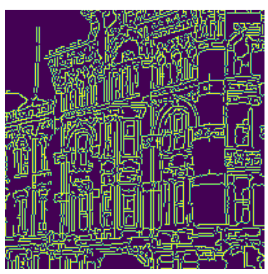

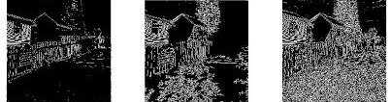
Example: Canny Edges of Image

Slide 34
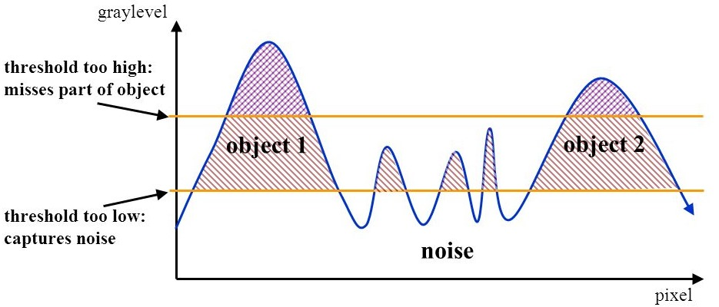
Hysteresis
Hysteresis is used to improve edge detection by connecting edges that are strong enough to form meaningful boundaries. Apply two thresholds: a high threshold to identify strong edges and a low threshold to identify weak edges. Connect weak edges to strong edges if they are in the neighborhood.

Slide 35
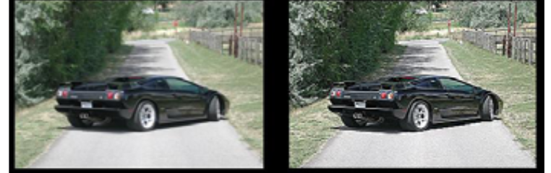
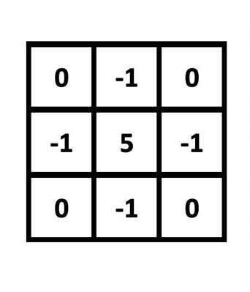
Image Sharpening
Sharpening Kernel

Slide 36
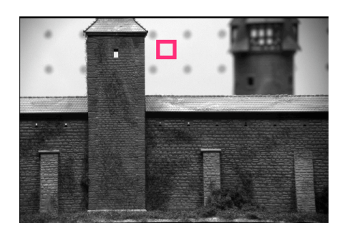
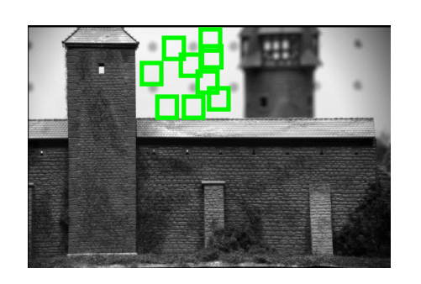
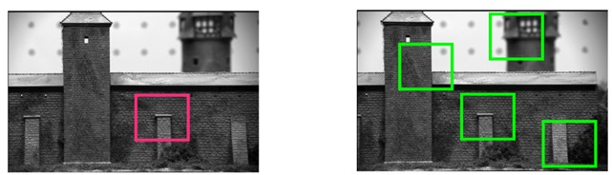
Image Matching
Feature: Features are the local keypoints in images based on which we can match those images. These matching features are used in object detection.
Plane and edge are not good feature points, but corners are as they are not the same in both images to be matched.

Slide 37
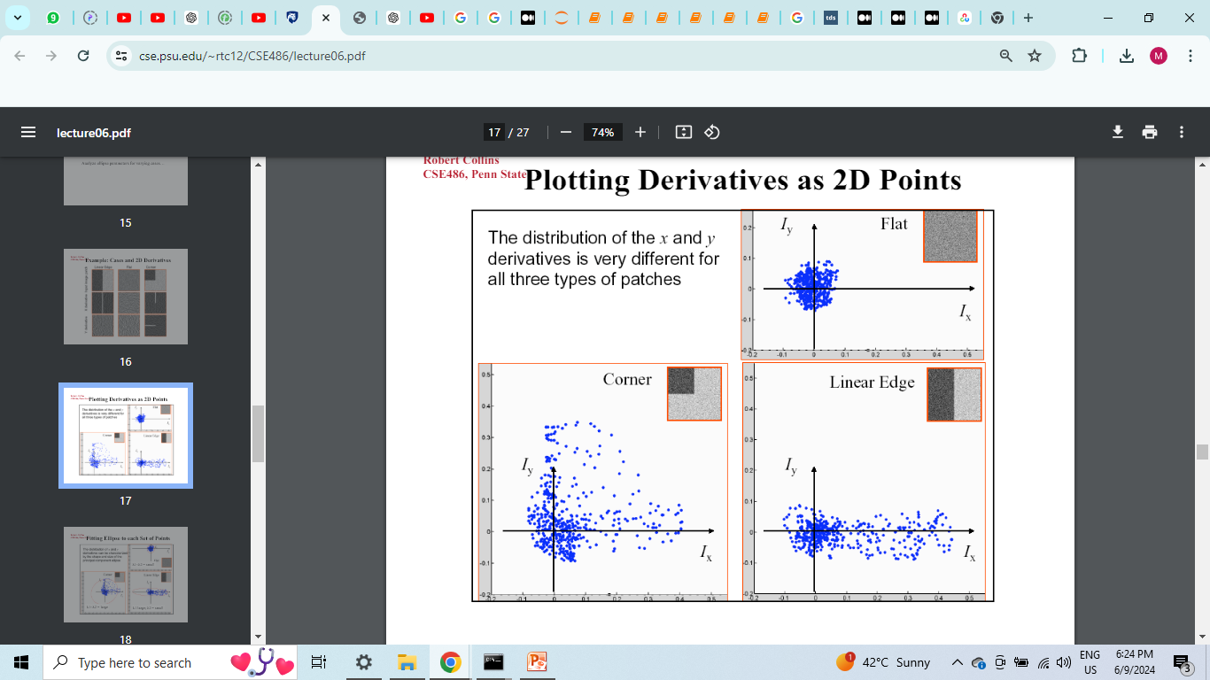
Harris Corner Detection Algorithm
When we shift the window/patch in the image by a small distance, there is no change in case of planes, change in one direction in case of edges. If the window is on corners, there is change in both directions(x,y) on shifting.
Thus on shifting very little, there is significant difference in both directions, and hence corner can be detected.

Slide 38
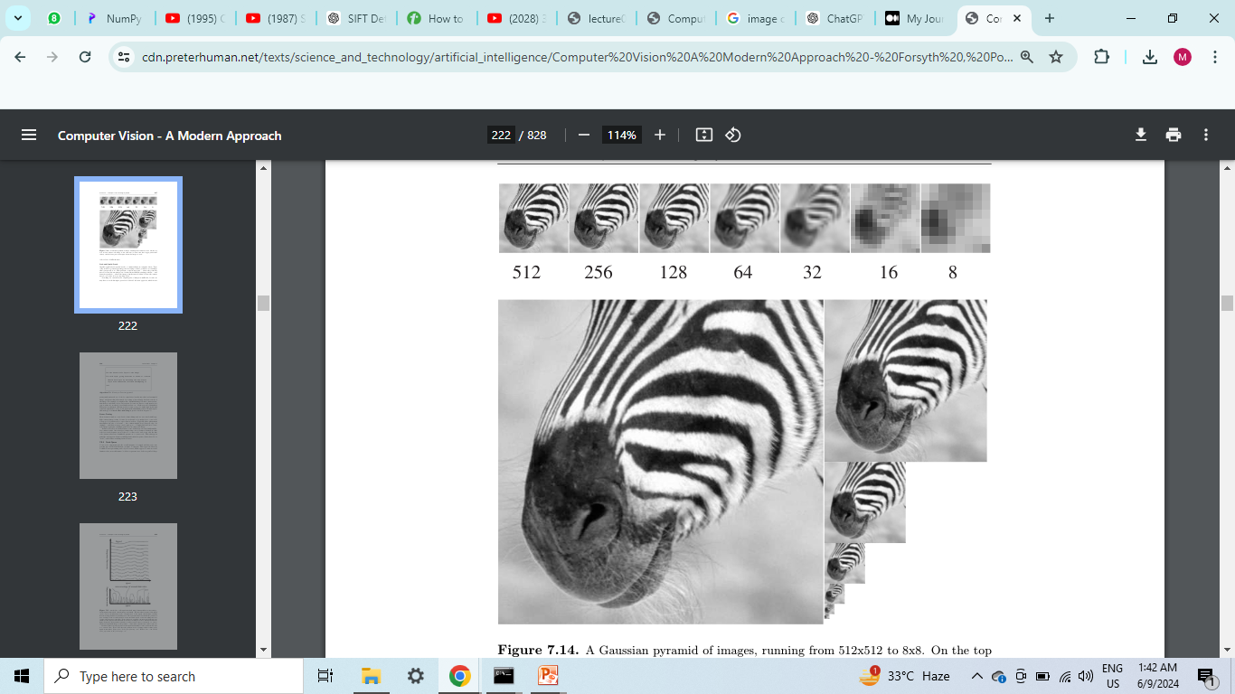
What are the issues with this??
Issues with Harris Corner algorithm for corner detection:-
Translation Invariance
Rotational Invariance
Scale Invariance
Illumination Invariance
To handle scale invariance we use image pyramid.
Image pyramid is a multi-scale representation of an image, constructed by creating a series of progressively smaller images, typically by repeatedly applying Gaussian smoothing and downsampling. At each stage, compare image with the other.

Slide 39
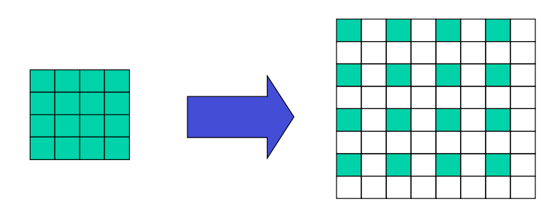
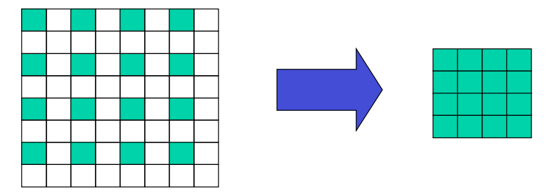
Downsampling & Upsampling
Downsampling
Upsampling
Downsampling involves first smoothening the image with gaussian kernel, and then downsampling or reducing the size of the image by a half(or any other factor)
Blur Downsample
Upsampling is increasing of the spatial resolution while keeping the 2D representation of an image.This process is also called Bi linear Interpolation.
Upsample Blur

Slide 40
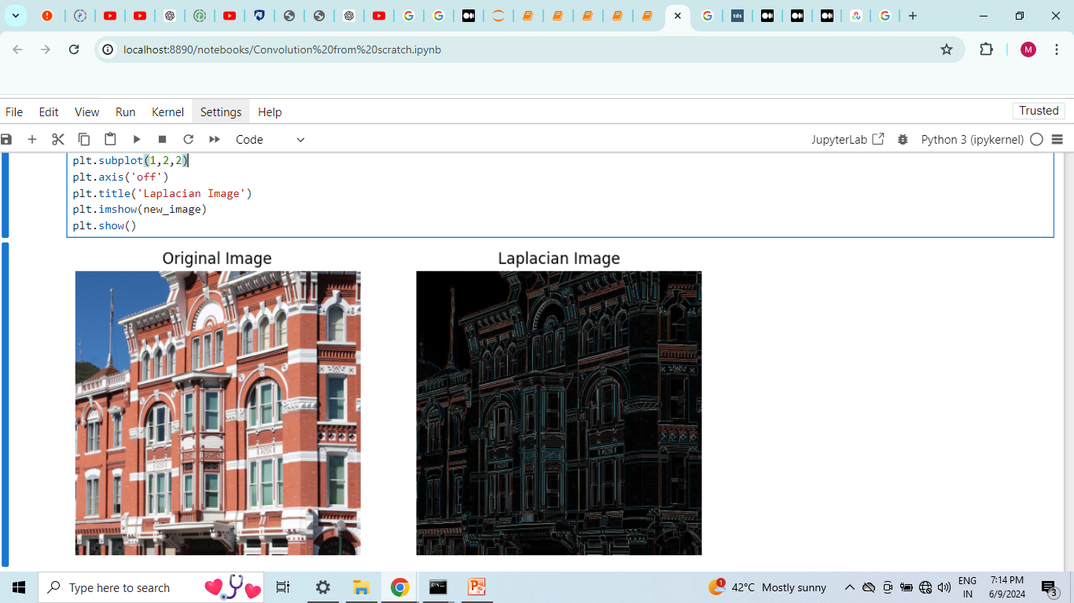
LoG
LoG is Laplacian of Gaussian. It is determined by first applying gaussian filter on the image and then taking it’s double derivative , which yields in very high intensity blobs which are considered amazing features.
We approximate LoG with DoG as LoG has high time complexity and it is difficult obtain.

Slide 41
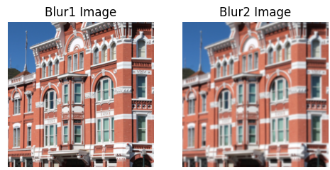
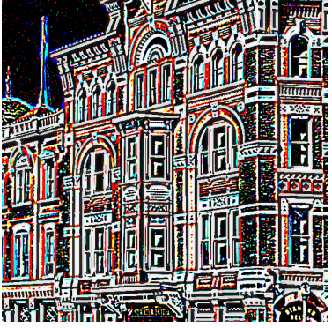
DoG
DoG stands for Difference of Gaussian. It’s constructed by subtracting two Gaussian-blurred images at different scales.
DoG: Blur1 - Blur2

Slide 42

Laplacian Pyramid
Laplacian Pyramid is Constructed by creating a Gaussian pyramid and then computing the difference between each level and the next (higher) level upsampled to the same size.

Slide 43
SIFT
SIFT is Scale Invariant Feature Transform. SIFT is scale invariant because of Laplacian Pyramid.
It can be made rotational invariant by taking the directions of the derivative and then aligning all of them in same direction.
It is illumination invariant as there exists only high intensity blobs and nothing else.
It can also be made translational invariant by moving the DoG to the centre. Thus, SIFT helps in image matching.

Slide 44

Image Matching

Slide 45

Histogram of Oriented Gradients
HoG is also a feature descriptor for the purpose of image matching. The technique counts occurrences of gradients oriented in localized portions of an image.

Slide 46
Transformations, camera and its Projections
Translation:- Translation is a fundamental geometric transformation involving the shifting of an object within an image from one location to another.
Scaling:- Scaling, a core geometric transformation, involves resizing an image in the horizontal (x) and/or vertical (y) directions.

Slide 47

Rotation:- Rotation is a geometric transformation that involves changing the orientation of an image by a specified angle around a given axis or point.
Affine:- Affine involves shifting the pixel values of an image either horizontally or vertically, but the shift is not uniform across the image. This creates a distorted effect by displacing parts of the image in different directions.
Projective:- In this transformations, the points of intersection are the only invariants. Here it is 8 degree freedom.

Slide 48

2D Planar Transformations

Slide 49



Camera Caliberation
Camera Coordinates

Slide 50


Coordinate Systems

Slide 51


World to Camera Transformation

Slide 52


Relation between Camera-CS & World-CS
World coordinates to Camera coordinates
Camera coordinates to World coordinates

Slide 53


Affine Transformation
Here, Ox and Oy called image centre or principal point.

Slide 54


Overview

Slide 55


Depth From Stereo
It is not possible to estimate the depth of a point object P from the camera using a single camera O, as all positions of P are mapped to the same point p in image.
We can get the area of original points but not the actual depths

Slide 56


Solution : Stereo vision is a technique used to estimate the depth of a point object P from the camera using two cameras. So the intersection of two lines gives the depth of original point.
Types of Stereo systems:-
Parallel System Generalized System

Slide 57

Multi-View Geometry
Structure from Motion:
In this, we focus different cameras at different angles on the same object whose depth is to be estimated. Then it will make different lines of view, and their intersection point gives the exact position of the object in the world space.
In this, we keep a single camera revolve it around the object in a circular motion, and capture the images of the same object, thus forming different lines of view. Then, their intersection point gives the depth of the object in the real world.

Slide 58

Simplified case for Stereo
Bullet points:-
If base line is more, depth estimation becomes easy, but the common region gets reduced.
Therefore, we increase the base line and rotate the cameras. But then we also need to have the rotation component of transform, as it will not be Identity matrix.

Slide 59

Concept of Epipolar Region
Epipole is the point of intersection of the line connecting the camera centers (baseline) with the image plane. Each camera in a stereo pair has an epipole, which is the projection of the other camera's center onto its image plane..

Slide 60

Epipolar plane is formed by a 3D point and the two camera centers is called the epipolar plane. This plane intersects the image planes along lines called epipolar lines
Epipolar lines are the intersections of the epipolar plane with the image planes. A point in one image corresponds to a point along the epipolar line in the other image.

